Slide 1
Multithreaded File Transfer using TCP Socket in Python
18CSS302J - Computer Networks Course Project: Review - I

Slide 2
What is Multi-Threading?
Multi-Threading refers to concurrently executing multiple threads by rapidly switching the control of the CPU between threads (called context switching).
A thread is a unit of execution within a process.

Slide 3
Problem statement
A multithreaded file transfer client-server program build using a python programming language. The server has the capability to handle multiple clients concurrently at the same by using threading. The server assigns each client a thread to handle working for that client.

Slide 4
Project Overview
The server program can handle an arbitrary number of concurrent connections and file exchanges, only limited by system configuration or memory. The server is started without any parameters and creates a TCP socket at an OS-assigned port. It prints out the assigned port number and stores it in a local file port, which is used when starting clients. The server listens on its main socket and accepts client connections as they arrive. Clients perform an upload or download operation, or instruct the server to terminate.

Slide 5
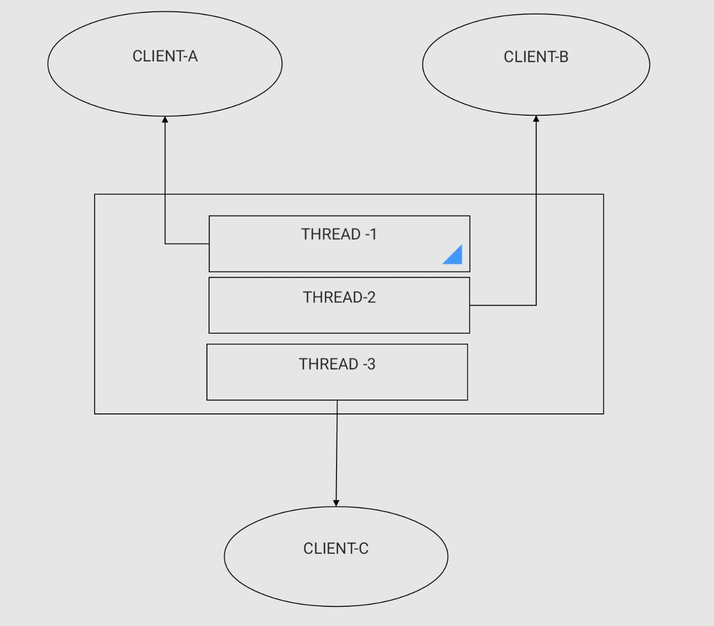
Architecture
FILE TRANSFER
FILE TRANSFER
SERVER PROCESS
FILE TRANSFER

Slide 6
BASIC FUNCTIONALITIES
LIST: List all the files from the server.
UPLOAD: Upload a file to the server
DELETE : Delete a file from the server
LOGOUT: Disconnect from the server
HELP: List all the commands

Slide 7
Requirements
Hardware Requirements
Processor : 2.4 GHz Clock Speed
RAM : 1 GB
Hard Disk : 500 MB (Minimum free space)
Software Requirements
Operating System : Windows 7
Platform : Python
Special Tools : Opencv
Xuggle Server : Apache Tomcat

Slide 8
ALTERNATIVE SOLUTION:
DRAWBACKS IN MULTITHREADING :
1 .Threads are difficult to code,debugs and sometimes they have unpredictable results.
2.Overhead switching of context.
3.Not scalable for large number of clients.
4.Deadlocks can occur.

Slide 9
SELECT() : A better way to handle multiple clients using select() linux command.
HOW THIS IS BETTER ?
Select command allows to monitor multiple file description,waiting until one of the file descriptors become active.
For example, if there is some data to be read on one of the sockets select will provide that information.Select works like an interrupt handler, which gets activated as soon as any file descriptor sends any data.

Slide 10
SERVER CODE
import os
import socket
import threading
IP = socket.gethostbyname(socket.gethostname())
PORT = 4456
ADDR = (IP, PORT)
SIZE = 1024
FORMAT = "utf-8"
SERVER_DATA_PATH = "server_data"
def handle_client(conn, addr):
print(f"[NEW CONNECTION] {addr} connected.")
conn.send("OK@Welcome to the File Server.\nEnter 'HELP' to get list of commands.".encode(FORMAT))
while True:
data = conn.recv(SIZE).decode(FORMAT)
data = data.split("@")
cmd = data[0]

Slide 11
if cmd == "LIST":
files = os.listdir(SERVER_DATA_PATH)
send_data = "OK@"
if len(files) == 0:
send_data += "The server directory is empty"
else:
send_data += "\n".join(f for f in files)
conn.send(send_data.encode(FORMAT))
elif cmd == "UPLOAD":
name, text = data[1], data[2]
filepath = os.path.join(SERVER_DATA_PATH, name)
with open(filepath, "w") as f:
f.write(text)
send_data = "OK@File uploaded successfully."
conn.send(send_data.encode(FORMAT))
elif cmd == "DOWNLOAD":
name = data[1]
filepath = os.path.join(SERVER_DATA_PATH, name)

Slide 12
with open(filepath, "r") as f:
text = f.read()
filepath = data[2]
with open(filepath, "w") as f:
f.write(text)
send_data = "OK@File downloaded successfully."
conn.send(send_data.encode(FORMAT))
elif cmd == "DELETE":
files = os.listdir(SERVER_DATA_PATH)
send_data = "OK@"
filename = data[1]

Slide 13
print(f"[DISCONNECTED] {addr} disconnected")
conn.close()
def main():
print("[STARTING] Server is starting")
server = socket.socket(socket.AF_INET, socket.SOCK_STREAM)
server.bind(ADDR)
server.listen()
print(f"[LISTENING] Server is listening on {IP}:{PORT}.")
while True:
conn, addr = server.accept()
thread = threading.Thread(target=handle_client, args=(conn, addr))
thread.start()
print(f"[ACTIVE CONNECTIONS] {threading.activeCount() - 1}")
if __name__ == "__main__":
main()

Slide 14
CLIENT CODE
import socket
import os
IP = socket.gethostbyname(socket.gethostname())
PORT = 4456
ADDR = (IP, PORT)
FORMAT = "utf-8"
SIZE = 1024
CLIENT_PATH = "client_data"
def main():
client = socket.socket(socket.AF_INET, socket.SOCK_STREAM)
client.connect(ADDR)
while True:
data = client.recv(SIZE).decode(FORMAT)
cmd, msg = data.split("@")

Slide 15
if cmd == "DISCONNECTED":
print(f"[SERVER]: {msg}")
break
elif cmd == "OK":
print(f"{msg}")
data = input("> ")
data = data.split(" ")
cmd = data[0]
if cmd == "HELP":
client.send(cmd.encode(FORMAT))
elif cmd == "LOGOUT":
client.send(cmd.encode(FORMAT))
break
elif cmd == "LIST":
client.send(cmd.encode(FORMAT))
elif cmd == "DELETE":
client.send(f"{cmd}@{data[1]}".encode(FORMAT))
elif cmd == "UPLOAD":
path = data[1]

Slide 16
with open(f"{path}", "r") as f:
text = f.read()
filename = path.split("/")[-1]
send_data = f"{cmd}@{filename}@{text}"
client.send(send_data.encode(FORMAT))
elif cmd == "DOWNLOAD":
filepath = os.path.join(CLIENT_PATH, data[1])
client.send(f"{cmd}@{data[1]}@{filepath}".encode(FORMAT))
print("Disconnected from the server.")
client.close()
if __name__ == "__main__":
main()

Slide 17
REPORT BY
HASWANTH
KIRAN
PAVAN
HEMANTH
KIREETI

